Slide 1




Data-Limited Fisheries Toolkit
Evaluating management strategies for data-limited fish species
A simple ‘no frills’ run of DLMtool
Lecture 2b, Nov 1st 2017
Tom Carruthers & Adrian Hordyk .

Slide 2
Agenda
OO design: Stock, Fleet, Observation and Implementation objects
Constructing operating models
Visualizing operating models
Run an MSE
Visualize MSE runs
Evaluate performance
Trade-off plots

Slide 3
1. OO design: Stock, Fleet, Observation and Implementation objects
Recall the MSE schematic:
System dynamics
Stock dynamics
Fleet dynamics
‘True’ data
Observation model
Actual management result
Observed data
Implementation model
Management procedure (MP)
Management recommendation

Slide 4
1. OO design: Stock, Fleet, Observation and Implementation objects
DLMtool has various object classes to complete the MSE specification
System dynamics
Stock dynamics
Fleet dynamics
‘True’ data
Observation model
Actual management result
Observed data
Implementation model
Management procedure (MP)
Management recommendation

Slide 5
1. OO design: Stock, Fleet, Observation and Implementation objects
DLMtool has various object classes to complete the MSE specification
System dynamics
Observation model
Fleet
Obs
Stock
Implementation model
Management procedure
Output
Input
Imp

Slide 6
2. Constructing operating models.
Rapid building of operating model is relatively straightforward:
Search for object classes:
avail(‘Stock’)
avail(‘Fleet’)
avail(‘Obs’)
avail (‘Imp’)
Build an operating model:
myOM = new( ‘OM’, Rockfish,
Generic_Fleet,
Generic_Obs,
Perfect_Imp )

Slide 7
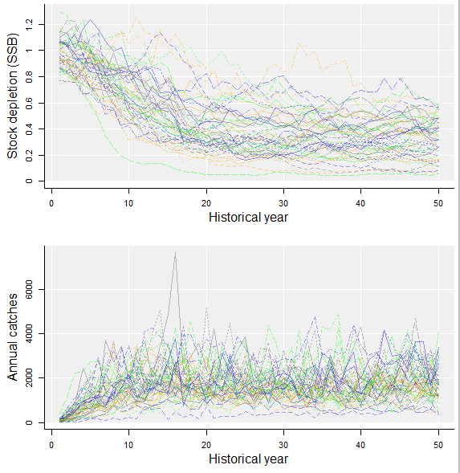
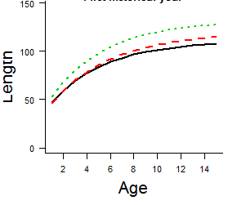
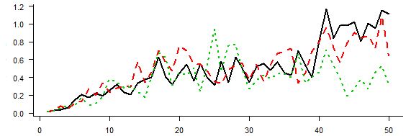
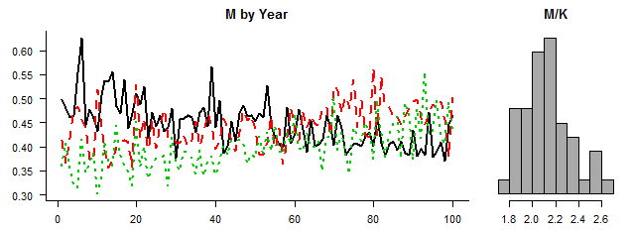
3. Once an operating model is built it can be visualized:
plot(myOM)
myMSE = runMSE( myOM, MPs = c(‘DCAC’ , ’DBSRA’) )
Growth
Biomass trends
Fishing effort trends
Natural mortality rate trends
Catch trends
M/K ratio
4. Or used in MSE analysis:

Slide 8
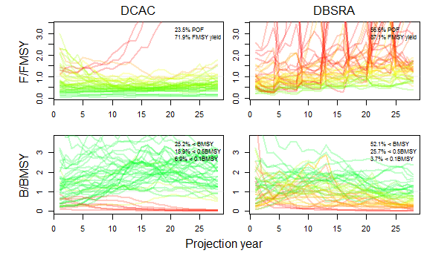
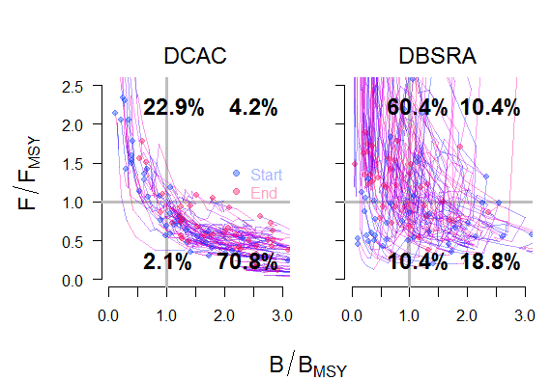
5. What occurred in the MSE runs can be visualized:
plot(myMSE)
6. Performance
quantified:
Kplot(myMSE)

Slide 9
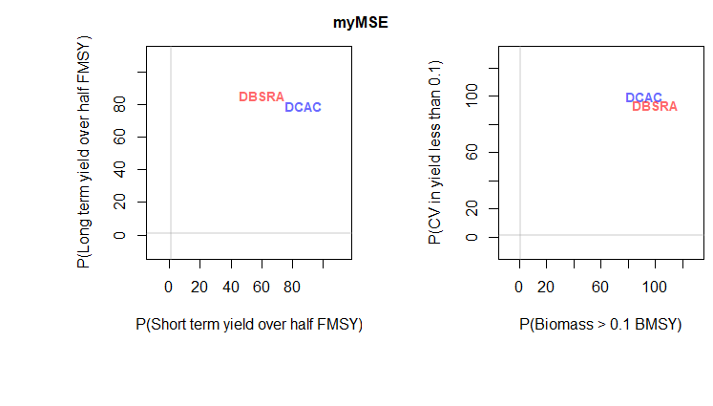
7. And performance trade-offs revealed
Tplot2(myMSE)

Slide 10
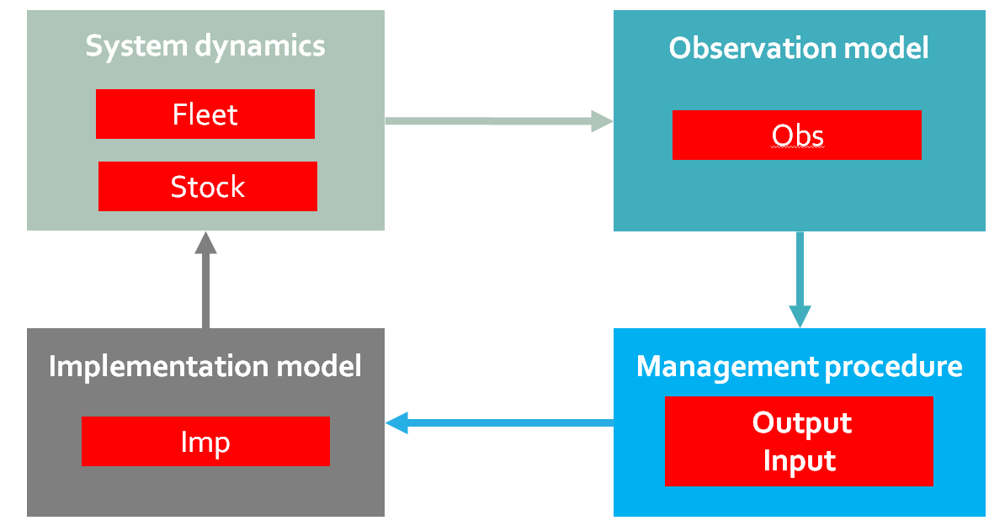
Summary of a basic run
myOM = new( ‘OM’, Rockfish, Generic_Fleet, Generic_Obs,
Perfect_Imp )
myMSE = runMSE( myOM, MPs = c(‘DCAC’, ‘DBSRA’) )
plot( myMSE )

Slide 11
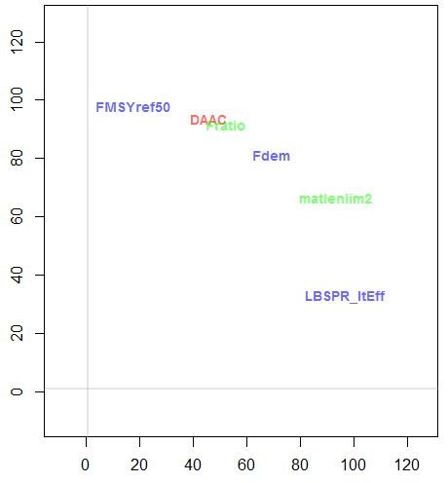
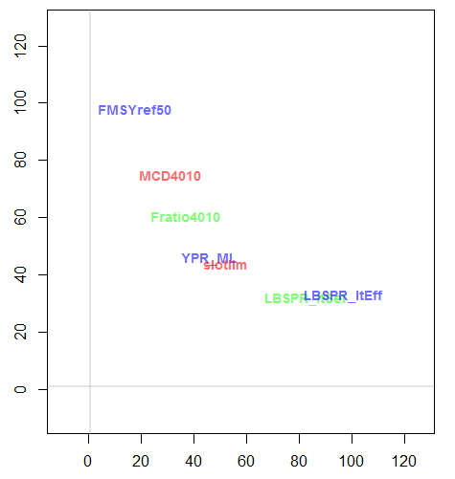
A bit more about trade-offs
“Hard problem”
Better
Yield over first 10 projected years
Worse
Probability of meeting long-term conservation objectives

Slide 12
Some handy commands
avail() avail(‘Stock’)
new() myOM = new(‘OM’)
plot() plot(myOM)
runMSE() myMSE = runMSE(myOM)
Tplot2() Tplot2(myMSE)

